Slide 1
Computer Vision
&
Go
Marian Montagnino
Golang Developer, Graymeta

Slide 2
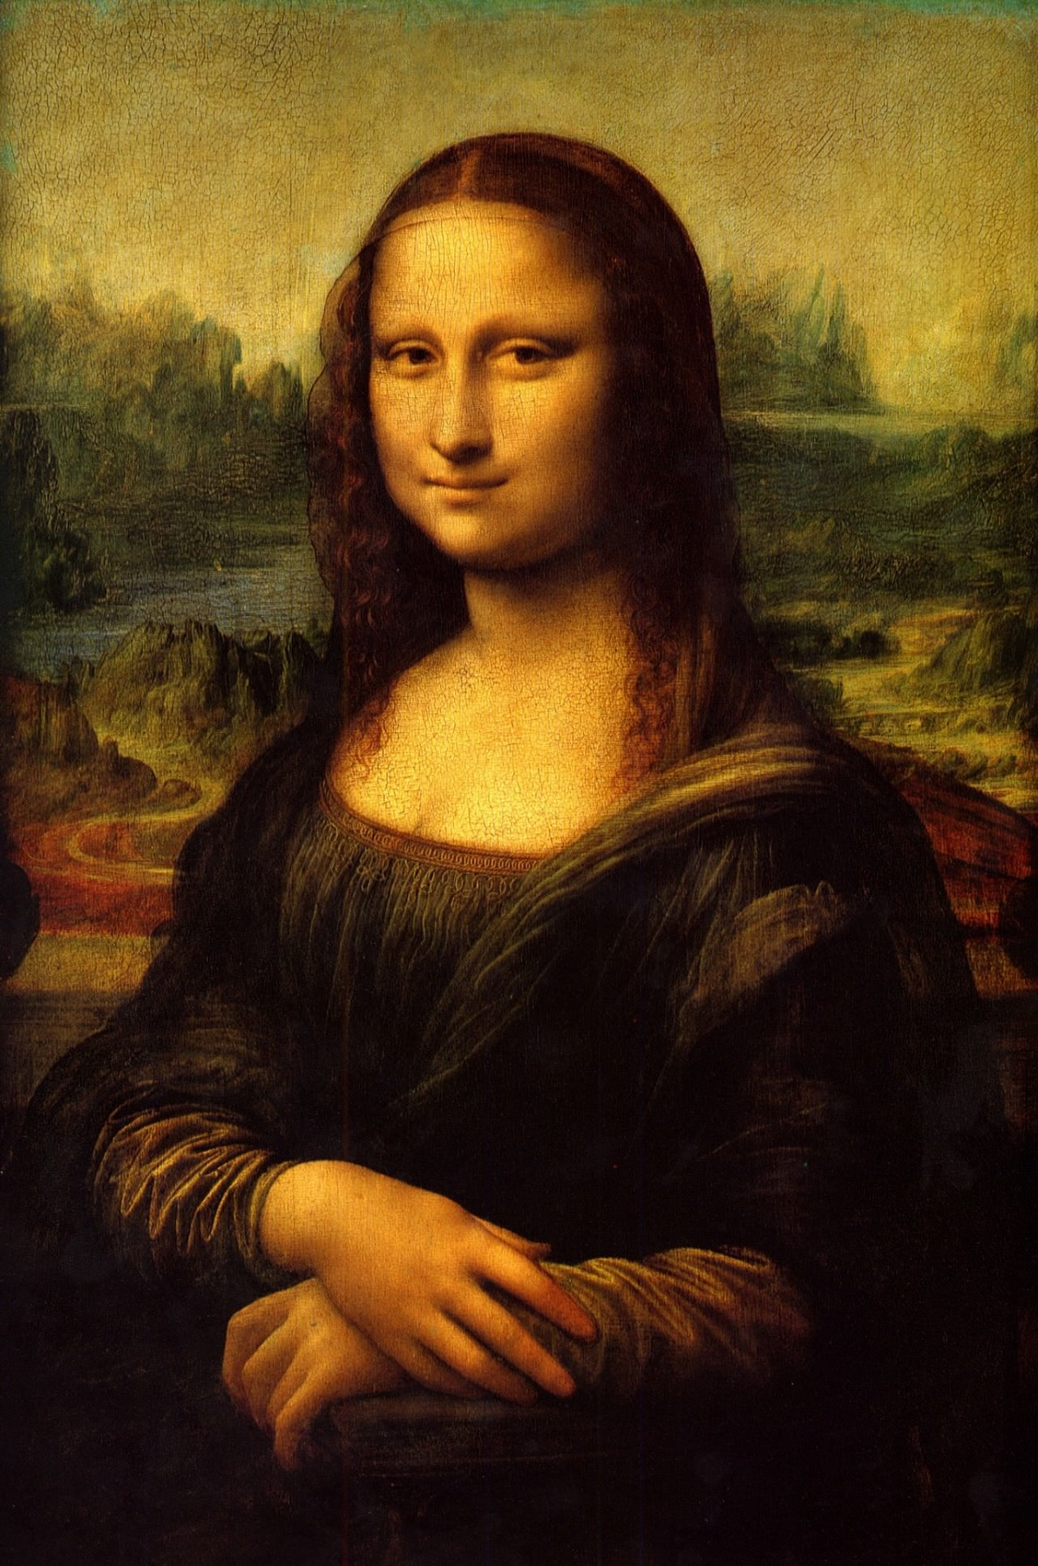


Discussion:
Computer Vision Use cases and available options to get started..
OpenCV: Benefits
OpenCV: Haar Cascade Training How to train a haar cascade
OpenCV: Object Detection Use your haar cascade file to detect objects in your image or video files.
Play with Haar Cascade Files Play around with images, video and live streams to see how your haar cascade successfully identifies trained objects

Slide 3
What can we do with Computer Vision?
Achieve a higher understanding from digital images, videos, or streaming.
Automate tasks that the human visual system can do and more:
Image Recognition
Houzz helps find similar products from images you like
The Flow app identifies products sold on Amazon to obtain detailed info.
Healthcare: dermatology, skin disease, cancer detection
OCR (Optical Character Recognition) Detection
Abbyys (TextGrabber) recognizes links, phone numbers, street, address and event details from images and makes them clickable
Google Translate app recognizes foreign characters and translate to English. Text and form scanning for health care, banking, retail services.

Slide 4
What can we do with Computer Vision?
Image Improvement
Meitu photo filter beautification app
FaceApp allows users to see what their body will look like after plastic surgery
Image Generation
AutoDraw analyzes user’s doodles and suggests more polished pieces of clip art to replace them
Create movies, cartoons or videos from a still image.

Slide 5
Computer Vision Libraries + APIs
Open Source Libraries (Golang):
Go-YOLO
YOLO (You Only Look Once)
https://github.com/ZanLabs/go-yolo
GoCV
Haar (Viola-Jones), HOG, SIFT + SURF algorithms
https://github.com/hybridgroup/gocv
Most Computer Vision RESTful APIs:
Google Vision (https://cloud.google.com/vision/)
Amazon Rekognition (https://aws.amazon.com/rekognition/)
Microsoft Azure Computer Vision (https://azure.microsoft.com/en-us/services/cognitive-services/computer-vision/ )

Slide 6
GoCV + OpenCV + Haar Cascade Training
OpenCV:
BSD-licensed product, OpenCV makes it easy for businesses to utilize and modify the code.
Written in C/C++ so it’s fast.
Low memory usage.
Portable to any machine that can run C.
Haar cascades:
Typical size of a good haar cascade file is small (ie. <500KB)
Easily store thousands of haar cascade files to detect different objects

Slide 7
Getting started with OpenCV
Setup your Environment.
Visit https://gocv.io and follow the installation directions to get setup:
Install the GoCV package
Install OpenCV 3.4 using Homebrew
Build/run Go code
Tip
GoCV gives programmers who use the Go programming language access to the OpenCV 3 computer vision library.
Notes:
GoCV gives programmers who use the Go programming language access to the OpenCV 3 computer vision library.

Slide 8
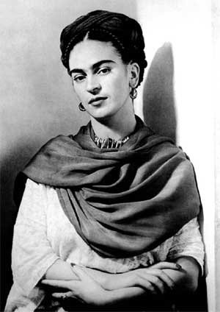
Haar Cascade Files
The Viola–Jones object detection framework is the first object detection framework to provide competitive object detection rates in real-time proposed in 2001 by Paul Viola and Michael Jones
A cascade classifier basically tells OpenCV what features (similar properties) to look for in images to detect the object
Best for fixed object detection: Logos, Signs, Frontal Faces, Text detection

Slide 9
Training Haar Cascade File
Collect “Negative” or “background” images
Any image will do, just make sure the object you’re trying to detect does not exist in the image. Get thousands.
Collect or create “Positive” images
Need thousands of images. Can make these based on a single image, or manually created.
Create a positive vector file by stitching together all generated positive samples
Train cascade file.
Tip
You’ll need twice as many positive images as negative. Training on larger images will increase training time. Smaller images can also be used to efficiently detect features.

Slide 10
Negative/Background Files
Negative images do not contain the object you want to detect.
Need thousands of negatives images. Use sites like http://www.image-net.org/ to download files, or extract frames from a video file.
Convert files to grayscale
Resize each image so there’s a consistent height + width across all images. Visit my github haar-training repo to download a script written in go that will download images from imagenet, convert to grayscale, and resize. haar-training/save_images.go
Tip
Utilize free tools like ffmpeg to generate a large number of negative images:
ffmpeg -i <video_file> -vf format=gray,format=yuv422p,scale=100:100 frame_%05d.jpg

Slide 11
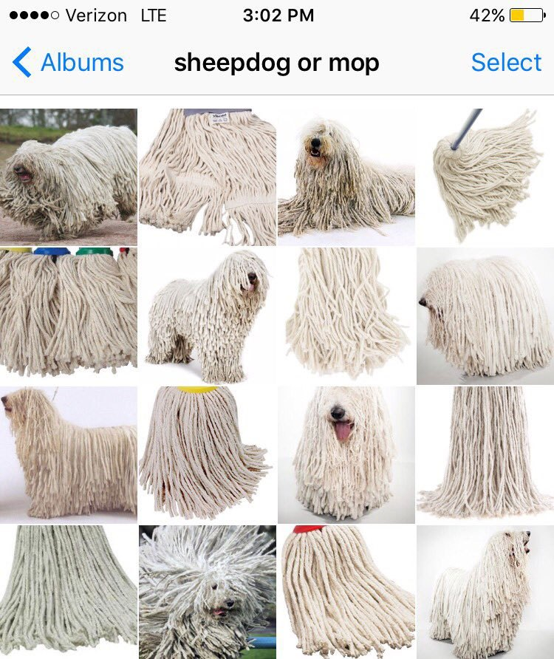
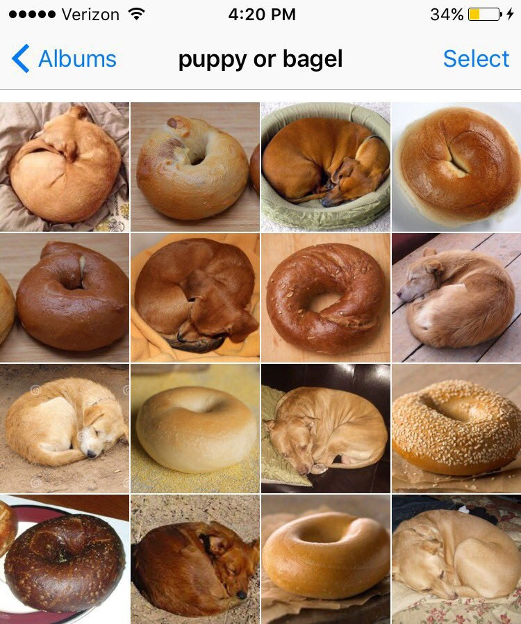
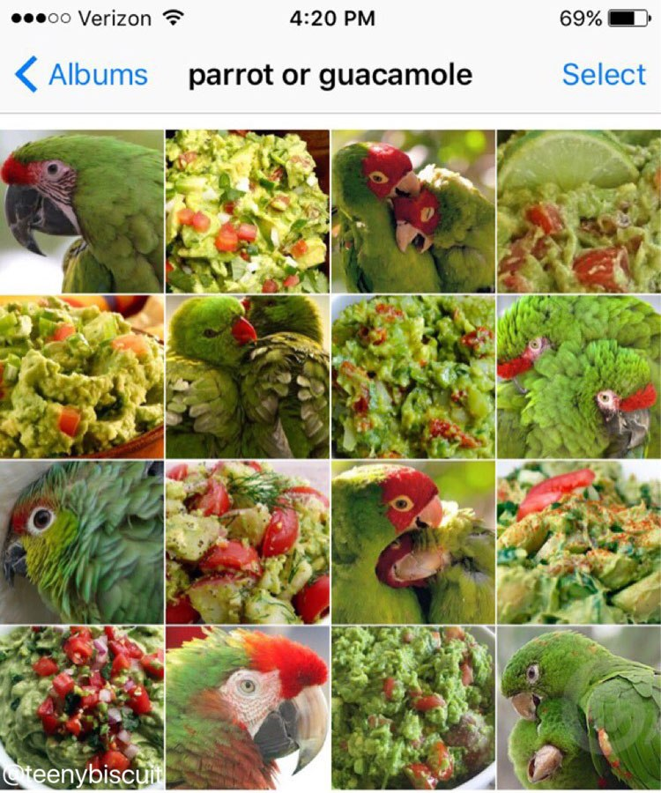
Negative/Background Files
Increase the accuracy of the haar cascade classifier by training on a lot of negative images that look like the object you want to recognize.

Slide 12
Positive Files
Positive images contain the object you want to detect.
Need thousands of positive images. Double or more the number of negatives.
Crop the positive images, so only the object you want to detect is shown.
Keep a consistent height + width across all images.
Tip
Utilize a script to create thousands of positive samples from just a handful of positive images.

Slide 13
Descriptor Files
Save positive and negative samples into descriptor files. These files contain an image file name (relative to the directory of the descriptor file) of negative or positive sample images.
For negative files: find ./neg -iname "*.jpg" > bg.txt
For positive files: find ./pos -iname "*.jpg" > pos.txt

Slide 14
Creating Positive Samples
Starting with a set of positive and negative images, run a script (utilizing OpenCV’s opencv_createsamples command line tool) to generate thousands of positive samples stitched together and saved as a .vec file.
Script takes each image and applies perspective transformation:
Random rotation, changing intensity, slight distortion on x,y,z axis
Superimpose distorted positive image over randomly chosen negative image
Visit my github haar-training repo to download a script written in go that will generate positive image vectors from just a handful of positive images. haar-training/create_samples.go
Tip
If you plan on generating positive vector files, make sure the height and width of the negative/bg images are larger than the the positive images.

Slide 15
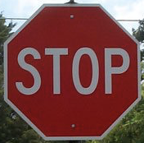
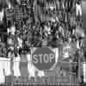
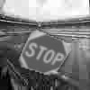
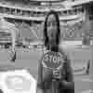
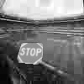
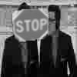
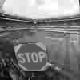
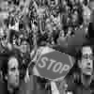
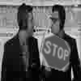
Generating Positive Samples

Slide 16
Merge Positive Samples
After generating a positive vector sample for each positive image, we’ll need to merge these files into a single positive vector file.
Golang script is based off of Naotoshi Seo’s mergevec C++ application: http://note.sonots.com/SciSoftware/haartraining/mergevec.cpp.html Allows you to merge vector files avoid having to add and recompile your opencv code.
Visit my github haar-training repo to download a script written in go that will merge vector files haar-training/mergevec.go.

Slide 17
Train your Haar Cascade
All folders (ie. “classifier” needs to be created before opencv_traincascade is run. Pass in the samples.vec (positive) file and bg.txt (negatives)
opencv_traincascade -data classifier -vec samples.vec -bg bg.txt\ -numStages 20 -minHitRate 0.999 -maxFalseAlarmRate 0.5 -numPos 1000\ -numNeg 600 -w 80 -h 40 -mode ALL -precalcValBufSize 1024\ -precalcIdxBufSize 1024
Visit https://docs.opencv.org/2.4/doc/user_guide/ug_traincascade.html to get more information on the parameters. Tweaking these modifiers will affect results of your haar cascade file.

Slide 18
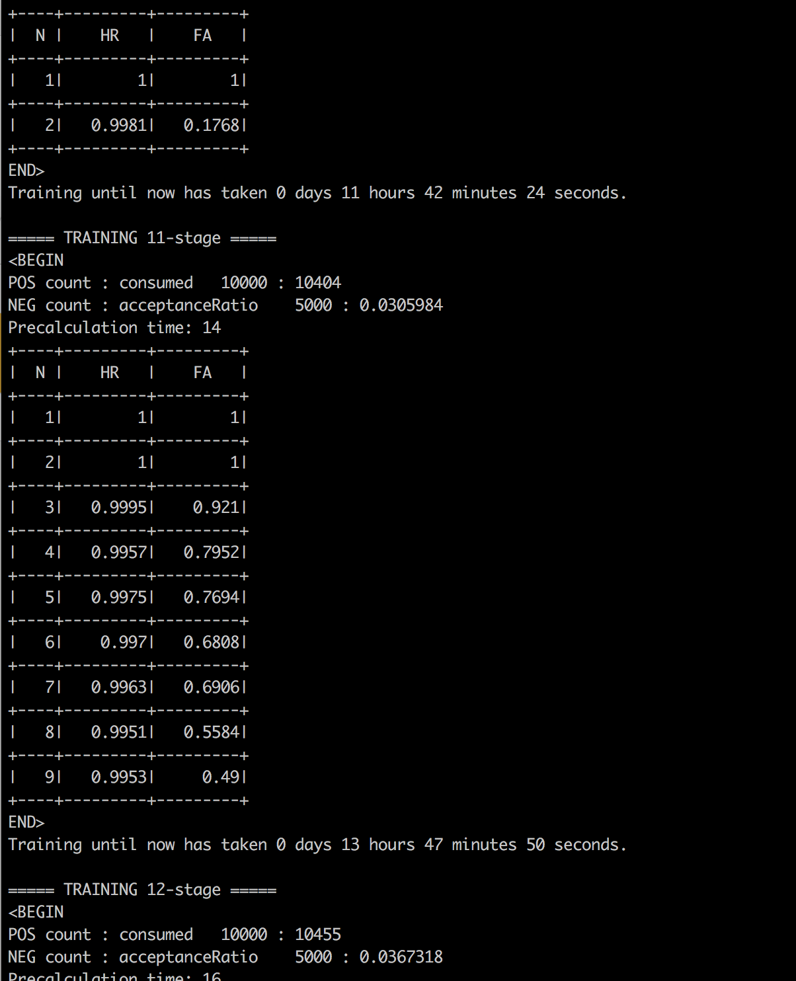
Training:
Takes a long time, often days and weeks to train a good haar cascade file.
In the process of training some useful data is returned:
HR (Hit Rate): How often we successfully detect the object.
FA (False Alarm): How often we mistakenly identify the object.
1/1 denotes 100% of the time.
Ideally you want a high HR and low FA.

Slide 19
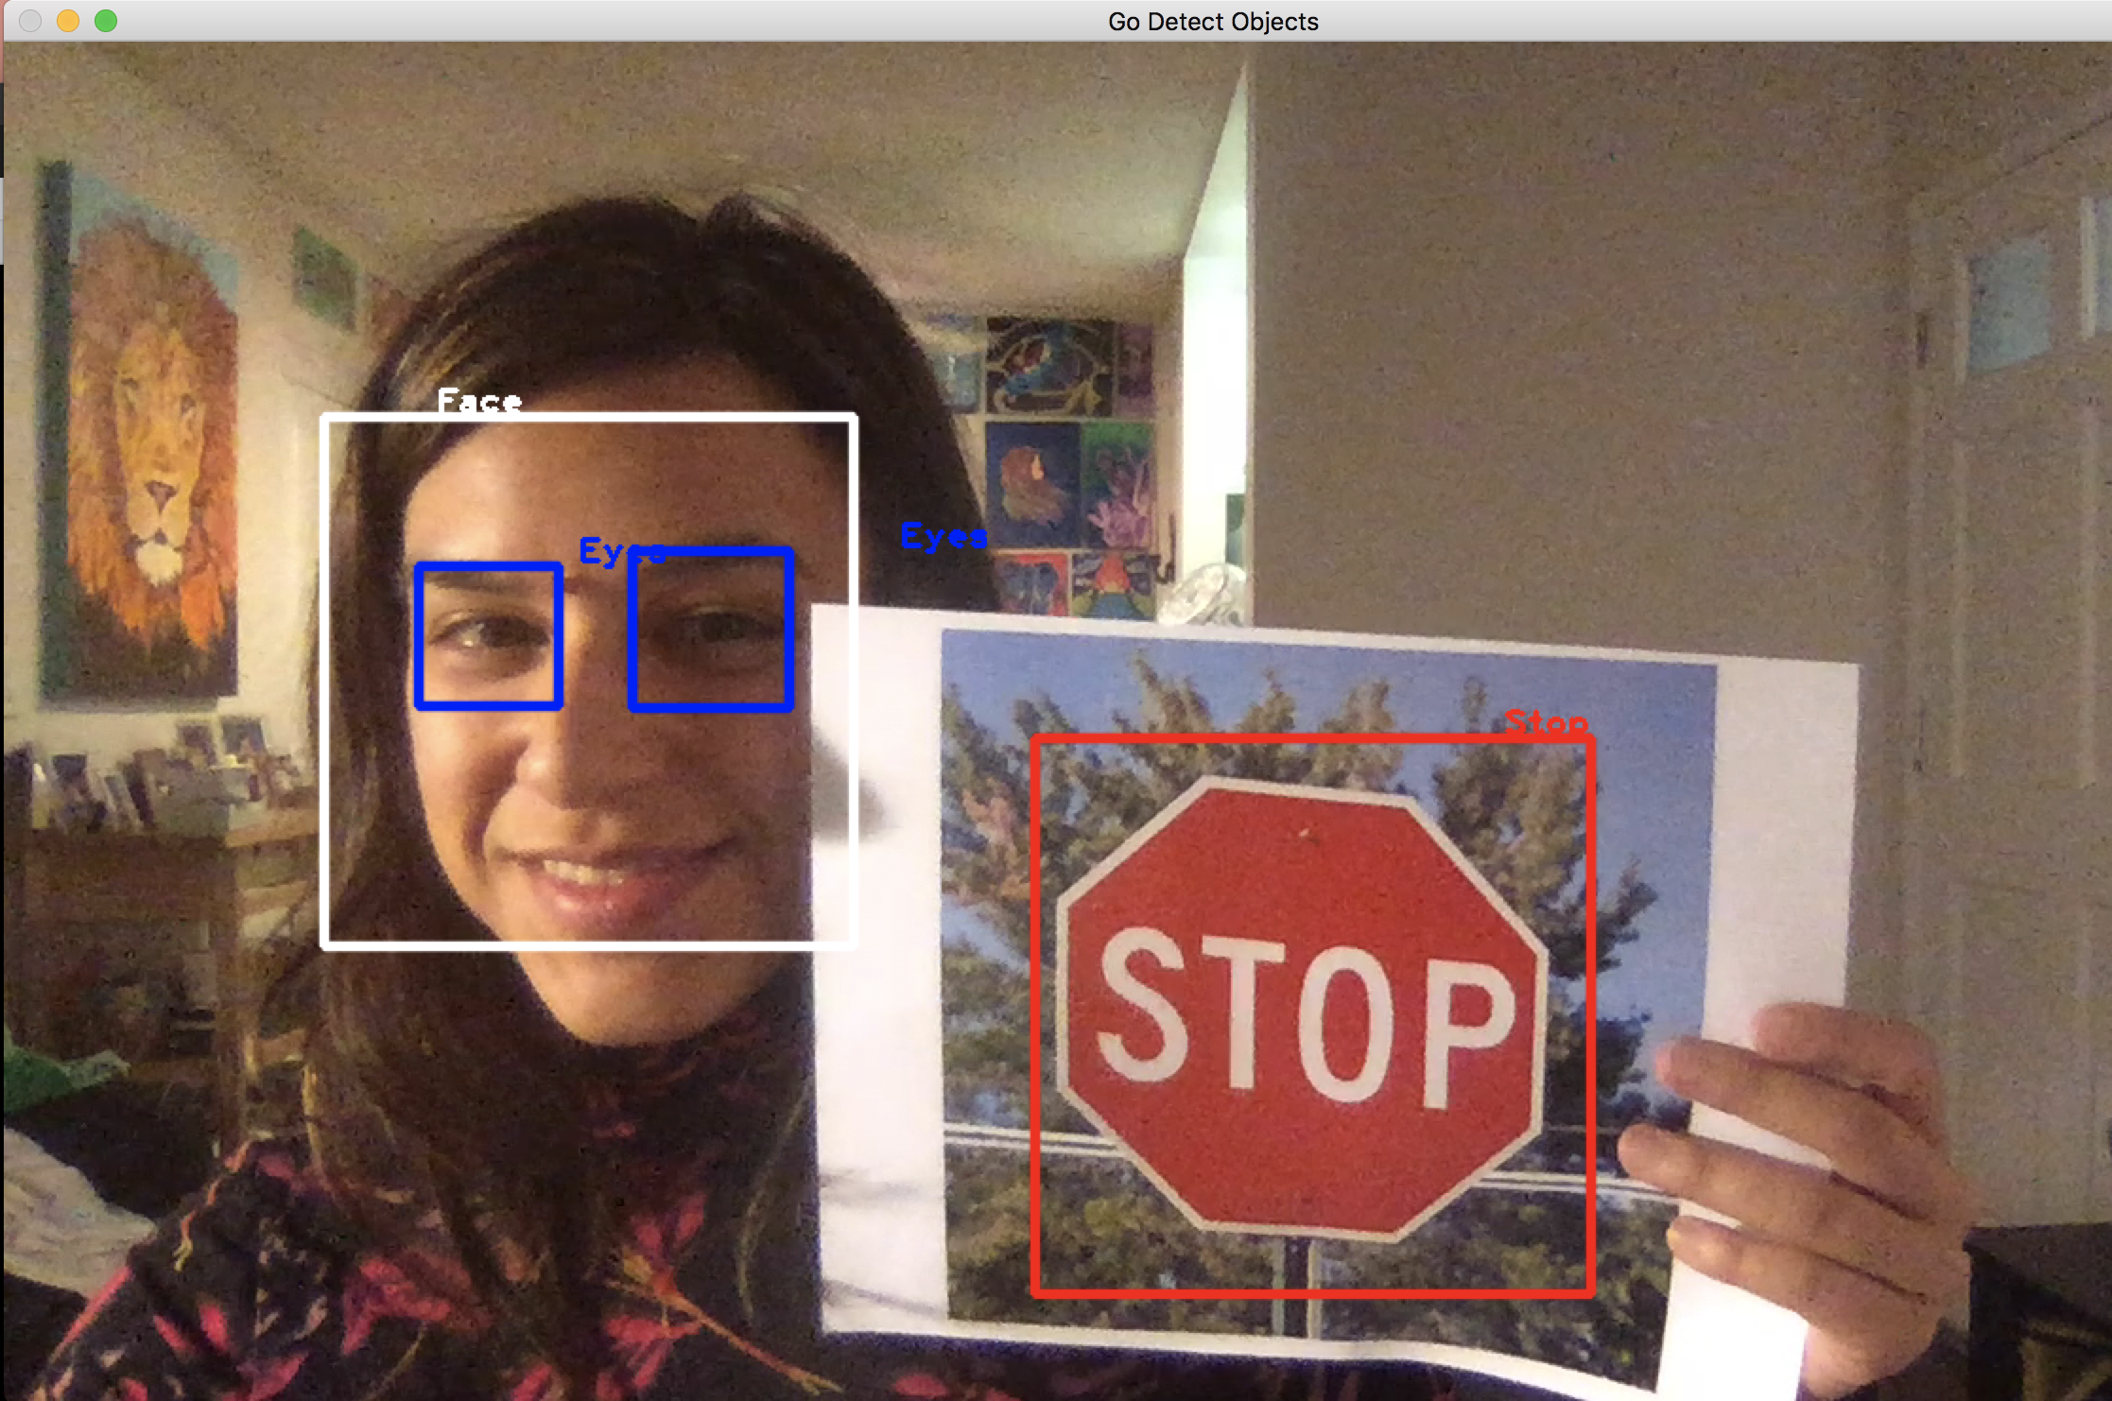
Result:
Once training is complete, you’ll find your cascade files under the data file specified when you ran the opencv_traincascade command.
GoCV has plenty of sample go files available that you can use to test your haar cascade file against an image file or live video stream.

Slide 20

Github: https://github.com/marianina8
Email: marian.montagnino@graymeta.com
If you have an interest in computer vision, data extraction, machine learning, and golang we’re hiring!

